Slide 1

AITECHGEN TECHNOLOGIES PVT. LTD.
STUDENT MANAGEMENT SYSTEM
Internship Project Presentation | MERN Stack Web Application
Intern
Kruthika S
Internship Period: September 2026
Project Duration: 2 Weeks

Slide 2
Project Overview
What was built and why
Project
Core Purpose
A full-stack Student Management System developed as a two-week internship mini project using the MERN Stack.
To understand CRUD operations, REST API integration, database connectivity and the complete full-stack development workflow.
Implemented Features
Add Student • View Students • Edit Student • Delete Student • Search Student • Course/Year Filtering • Pagination • Validation
AITechGen Technologies Pvt. Ltd. | Student Management System
2

Slide 3
Objectives
Technical and practical goals of the project
• Build a functional and user-friendly React.js interface.
• Develop RESTful APIs using Node.js and Express.js.
• Store student records persistently in MongoDB Atlas using Mongoose.
• Implement complete CRUD operations.
• Add search, course/year filtering and pagination.
• Implement required-field and duplicate Student ID validation.
• Use Git/GitHub for version control and documentation.
• Deploy the completed frontend and backend using Render.
AITechGen Technologies Pvt. Ltd. | Student Management System
3

Slide 4
Technology Stack
Technologies used across the application
Frontend
Backend
React.js + Vite
Interactive dashboard, forms and directory
Node.js + Express.js
REST API and server-side logic
Database
Communication
MongoDB Atlas + Mongoose
Persistent records and schema validation
Axios
HTTP communication between frontend and backend
Version Control
Deployment
Git + GitHub
Source control and project documentation
Render
Hosted frontend and backend services
AITechGen Technologies Pvt. Ltd. | Student Management System
4

Slide 5
System Architecture
Three-layer architecture and data flow
Presentation Layer
Application Layer
Data Layer
React.js + Vite
Dashboard • Forms • Directory
Node.js + Express.js
REST API • CRUD • Validation
MongoDB Atlas + Mongoose
Student records
Request Flow
User interaction → React.js → Axios/HTTP → Express REST API → Mongoose → MongoDB Atlas → JSON response → React.js
AITechGen Technologies Pvt. Ltd. | Student Management System
5

Slide 6
Functional Modules
Main modules implemented in the application
Dashboard
Student Registration
Overview of student records and quick actions.
Add student details with required-field validation.
Student Directory
Search & Filtering
Tabular view with edit and delete actions.
Search by ID/name/email/course; filter by course and year.
Edit Student
Delete Student
Update existing student information through PUT API.
Delete records after confirmation.
AITechGen Technologies Pvt. Ltd. | Student Management System
6

Slide 7
Search, Filtering & Pagination
Making the Student Directory easier to navigate
Search
Filters
Pagination
Student ID
Name
Email
Course
Course: CSE, ECE, EEE, DS
Year: 1–4
Filters can be combined
Maximum 5 records per page
Previous / Next / Page number controls
Workflow
Student Records → Search Term → Course Filter → Year Filter → Filtered Results → Pagination → Displayed Records
AITechGen Technologies Pvt. Ltd. | Student Management System
7

Slide 8
Database Design
MongoDB Atlas document model
Student Document
Validation
Database Operations
studentId — String — Unique
name — String — Required
email — String — Required
phone — String — Required
course — String — CSE/ECE/EEE/DS
year — String — 1/2/3/4
createdAt — Date
timestamp
updatedAt — Date
timestamp
Required fields
Unique Student ID
Allowed course values
Allowed year values
Lowercase email storage
Create: save()
Read: find(), findById()
Update: findByIdAndUpdate()
Delete: findByIdAndDelete()
Data Flow
React form → Axios → Express API → Mongoose Student model → MongoDB Atlas → API response → React interface
AITechGen Technologies Pvt. Ltd. | Student Management System
8

Slide 9
REST API Design
Five implemented endpoints
Method | Endpoint | Purpose
GET | /api/students | Retrieve all student records
GET | /api/students/:id | Retrieve a specific student
POST | /api/students | Add a new student
PUT | /api/students/:id | Update an existing student
DELETE | /api/students/:id | Delete a student record
API Flow
React.js → Axios → Express route → Mongoose → MongoDB Atlas → JSON response
AITechGen Technologies Pvt. Ltd. | Student Management System
9

Slide 10
CRUD Implementation
Core record-management operations
CREATE
READ
POST /api/students
Add Student form → API → MongoDB
GET /api/students
Retrieve and display student records
UPDATE
DELETE
PUT /api/students/:id
Edit form → API → updated record
DELETE /api/students/:id
Confirmation → API → record removed
AITechGen Technologies Pvt. Ltd. | Student Management System
10

Slide 11
Validation, Testing & Results
How correctness and data consistency were verified
Validation
Testing
Result
Frontend:
• Required-field checks
• Prevents incomplete submission
Backend:
• Required schema fields
• Course/year restrictions
• Unique Student ID
• Lowercase email
Delete confirmation is shown before removal.
CRUD operations
Search by name / ID / course
Course and year filters
Combined filters
Empty-field validation
Duplicate Student ID
Delete confirmation
Data persistence after refresh
Deployment verification
The implemented test cases produced the expected results.
Core requirements verified:
✓ CRUD
✓ Search
✓ Filtering
✓ Validation
✓ Data persistence
✓ Frontend–backend integration
✓ Deployed application
AITechGen Technologies Pvt. Ltd. | Student Management System
11

Slide 12
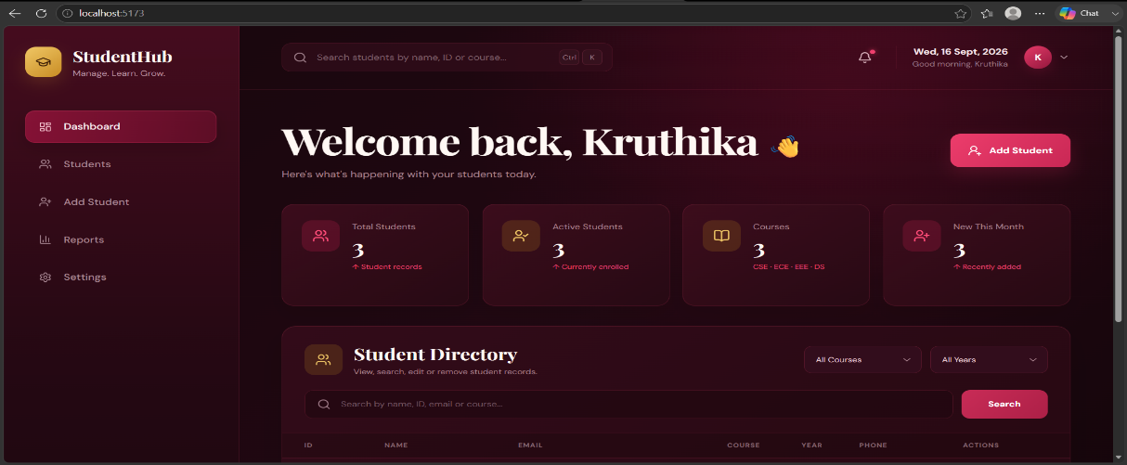
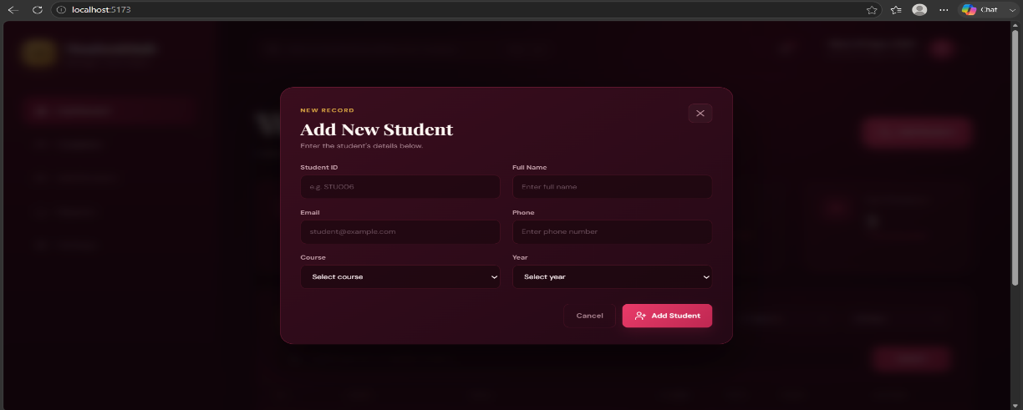
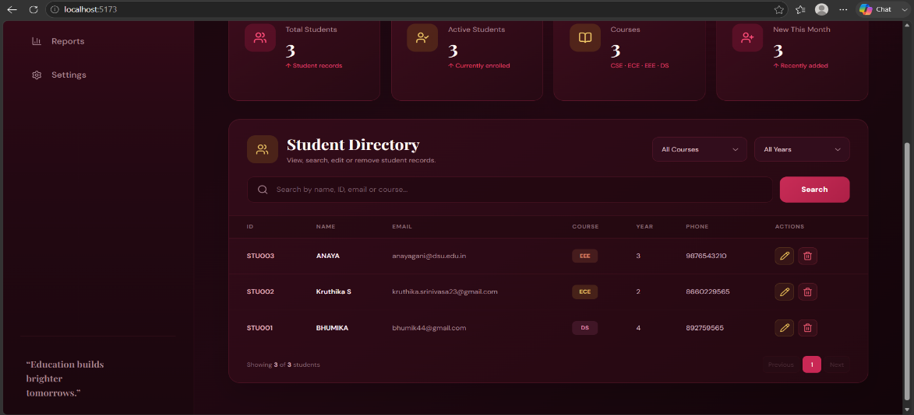
UI Design & Screenshots
Burgundy Luxe dashboard and student-management interface
Dashboard
Add Student
Student Directory
Design Principles
Consistency • Clarity • Navigation • Feedback • Responsiveness
AITechGen Technologies Pvt. Ltd. | Student Management System
12

Slide 13
Deployment & Live Application
Render hosting with MongoDB Atlas
Frontend
Backend
Database
Render Static Site
React.js frontend
Render Web Service
Node.js + Express.js REST API
MongoDB Atlas
Cloud student records
Deployment Verification
The deployed frontend was tested against the deployed backend API. CRUD operations, search, filtering and validation were verified after deployment. MongoDB Atlas network access was configured so the deployed backend could connect successfully.
Live Frontend
Live Backend
https://student-management-system-ijhy.onrender.com
https://student-management-api-qjhd.onrender.com
AITechGen Technologies Pvt. Ltd. | Student Management System
13

Slide 14
Development Challenges & Solutions
Practical issues encountered during implementation
Frontend–Backend Integration
MongoDB Atlas Connectivity
Verified API endpoints and tested CRUD requests individually.
Used environment variables and configured database network access.
CRUD Synchronization
Search & Filtering
Updated React state after add, edit and delete operations.
Combined search term, course and year conditions in frontend logic.
Validation
Deployment
Frontend required-field checks plus Mongoose constraints.
Resolved initial Atlas connectivity issue for the deployed backend.
AITechGen Technologies Pvt. Ltd. | Student Management System
14

Slide 15
Learning Outcomes
Skills gained through the internship project
• Full-stack development using the MERN Stack.
• React component design and application state management.
• REST API development with Node.js and Express.js.
• MongoDB/Mongoose schema design and CRUD operations.
• Frontend–backend–database integration using Axios.
• Validation, error handling and debugging.
• Git/GitHub repository management and documentation.
• Deployment of a full-stack application using Render.
• Practical understanding of the complete application lifecycle.
AITechGen Technologies Pvt. Ltd. | Student Management System
15

Slide 16
Future Enhancements
Possible extensions beyond the two-week project scope
01
02
03
User authentication and authorization
Role-based access for different users
Marks, grades and attendance management
04
05
06
Advanced reports and dashboard analytics
Advanced multi-criteria search
Notifications
07
08
09
Automated unit and integration testing
Production monitoring and CI/CD
Further mobile-friendly optimization
AITechGen Technologies Pvt. Ltd. | Student Management System
16

Slide 17
CONCLUSION
• The Student Management System was developed as a complete MERN Stack internship mini project.
• The application implements the required student record operations along with search, filtering, pagination and validation.
• The project connected React.js, Express.js, Node.js and MongoDB Atlas through REST APIs and Axios.
• Testing, documentation, GitHub version control and Render deployment completed the development lifecycle.
• The project provided practical experience in building, debugging, testing and deploying a full-stack web application.
GitHub Repository: https://github.com/kruthikasrinivasa/student-management-system
Thank You
AITechGen Technologies Pvt. Ltd. | Student Management System
17

